Slide 1

Creating dashboards in Excel

Slide 2
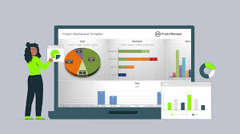
Dashboards
Dashboards in Excel are a great way to visualize data and communicate key insights in a clear, interactive format. Interactive dashboards provide a dynamic view of data. They combine visualizations like charts, graphs, and tables. The users can interact with dashboards to filter, drill down, and explore data. Dashboards enhance communication and data storytelling.

Slide 3
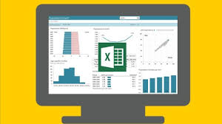
Steps to Create a Dashboard in Excel
1. Data Preparation:
Collect and organize your data. Data can come from various sources like Excel sheets, databases, or external systems.
Ensure your data is clean (free of duplicates, errors, and missing values).
Create structured tables for better management and flexibility

Slide 4
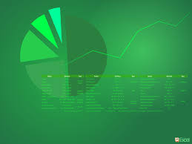
2. Data Analysis
Use Excel’s built-in functions (e.g., SUM,AVERAGE, COUNTIF, VLOOKUP, INDEX/MATCH , etc.) for calculations.
Leverage PivotTables to summarize data and identify trends.

Slide 5
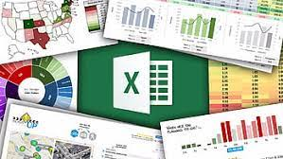
3. Creating Charts and Visualizations
Use different chart types to visualize data, such as
Bar/Column Charts: Great for comparing categories.
Line Charts: Effective for showing trends over time.
Pie Charts: Useful for displaying proportions.
Combo Charts: When you need to combine different types of data.
Conditional formatting can be applied to highlight key metrics.

Slide 6

4. Using PivotTables & Pivot Charts
Pivot Tables allow for dynamic reporting, letting you slice and dice data by different dimensions.
Pivot Charts are linked to PivotTables, providing an interactive way to visualize filtered data.

Slide 7
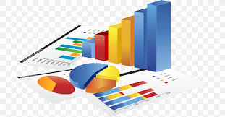
5. Adding Interactivity
Slicers: Allow users to filter data in PivotTables and PivotCharts.
Dropdowns/Combo boxes: You can create dynamic ranges for filtering data.
Form Controls (e.g., Buttons, Checkboxes): Enable further interaction with the dashboard.

Slide 8
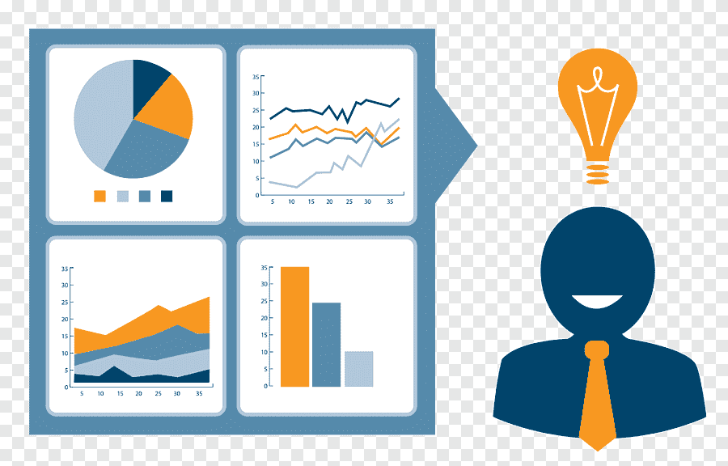
6. Layout and Design
Organize the dashboard layout for easy navigation.
Group related visuals and use clear titles and labels.
Maintain consistency with fonts, colors, and chart styles.

Slide 9
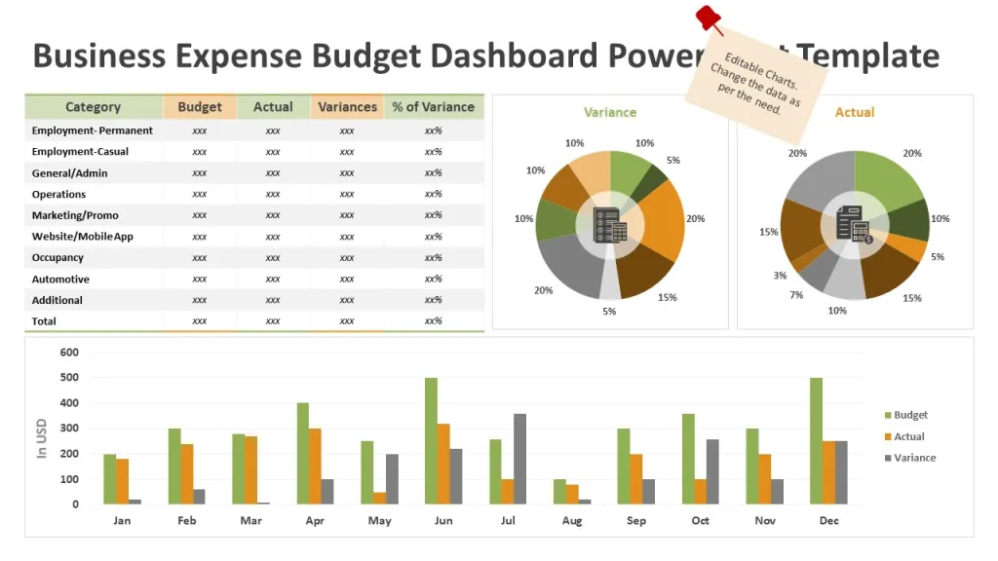
7. Final Touches
Remove any unnecessary gridlines, headings, or clutter
Use the "View" option to hide rows/columns or Excel ribbon for a cleaner look.
Ensure your dashboard is responsive by testing different filters and slicers.

Slide 10

Example Use Cases for Excel Dashboards
Sales Performance Dashboards: Track sales by region, product, or salesperson.
Financial Dashboards: Monitor expenses, revenues, and profitability.
HR Dashboards: Visualize employee performance, retention rates, and recruitment.
Marketing Dashboards: Measure campaign performance, customer engagement, and ROI.

Slide 11

Conclusion
A well-designed dashboard serves as an essential tool for businesses by transforming raw data into meaningful insights. It enables users to monitor key performance metrics, track trends, and make data-driven decisions in real time. By providing an interactive, visual representation of data through charts, graphs, and tables, dashboards improve communication, simplify complex data analysis, and enhance storytelling. In conclusion, dashboards are a vital asset for organizations looking to streamline reporting, boost productivity, and achieve better outcomes through informed decision-making.

Slide 12


Thank you
ajaycraju98@gmail.com

